Slide 1

MACHINE LEARNING CO – 327 DEPT OF COMPUTER SCIENCE AND ENGINEERING
UNDER THE SUPERVISION OF RUCHIKA MAM
SUBMITTED BY:SUNIL SAHU (2K18/CO/363)

Slide 2
FACE MASK DETECTION
USING MACHINE LEARNING

Slide 3
WHAT IS MACHINE LEARNING ?
Machine learning is a branch of Artificial Intelligence (AI) focused on building applications that learn from data and improve their accuracy over time without being programmed to do so.
In data science, an algorithm is a sequence of statistical processing steps. In machine learning, algorithms are 'trained' to find patterns and features in massive amounts of data in order to make decisions and predictions based on new data. The better the algorithm, the more accurate the decisions and predictions will become as it processes more data.

Slide 4
MOTIVATION
In the present scenario due to Covid-19, there is no efficient face mask detection applications which are now in high demand for transportation means, densely populated areas, residential districts, large-scale manufacturers and other enterprises to ensure safety. Also, the absence of large datasets of ‘with_mask’ images has made this task more cumbersome and challenging.

Slide 5
IDEA BEHIND
According to current scenario as we know a pandemic is going on all over the world and to get safe from this pandemic we need to do social distancing to avoid this disease to spread and we need to put a mask on our face so that this disease will not transfer from 1 person to another. So this is the main idea behind this so that it will help around the world

Slide 6
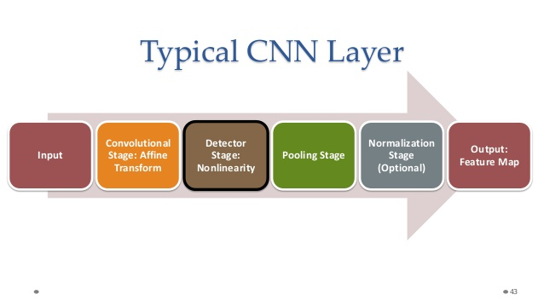
TECHNIQUE USED
CONVOLUTIONAL NEUTRAL NETWORK
Libraries Required :
NUMPY, OPENCV, MATPLOTLIB, TENSORFLOW
A convolutional neural network (CNN) is a specific type of artificial neural network that uses perceptions, a machine learning unit algorithm, for supervised learning, to analyze data. CNNs apply to image processing, natural language processing and other kinds of cognitive tasks.

Slide 7

VALIDATION TECHNIQUE
HOLD OUT VALIDATION :
Hold-out is often used synonymous with validation with independent test set, although there are crucial differences between splitting the data randomly and designing a validation experiment for independent testing. We have used 80% data set for training set and 20% for testing.
What is hold-out v/s cross validation ?
Hold-out vs. Cross-validation. Cross-validation is usually the preferred method because it gives your model the opportunity to train on multiple train-test splits. This gives you a better indication of how well your model will perform on unseen data. Hold-out, on the other hand, is dependent on just one train-test split.
PERFORMANCE MEASURES
Training and Validation Accuracy - Accuracy is the percentage of correct predictions by our model. As our dataset was imbalanced so accuracy was not a good measure to analyses performance of our model. Hence we have taken these additional performance measures.

Slide 8
DATA SET
Our dataset consist of picas with mask and without.
Our final result will also show the person wearing mask or not with the accuracy.
Our data set consist of 767 picas with or without mask.
In the 767 picas 384 without mask and 383 with mask
It has 224*224 dimension of the set and the target place.

Slide 9
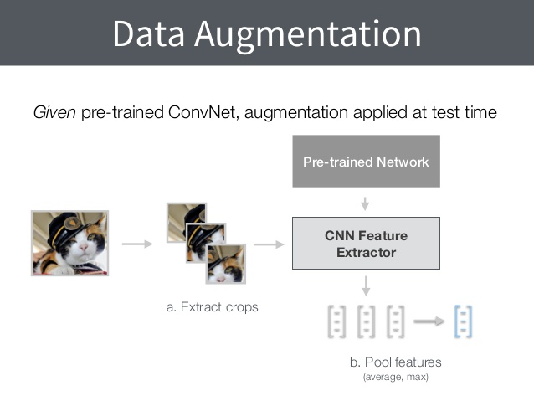
DATA PREPROCESSING
Data augmentation adds value to base data by adding information derived from internal and external sources within an enterprise. Data is one of the core assets for an enterprise, making data management essential.

Slide 10
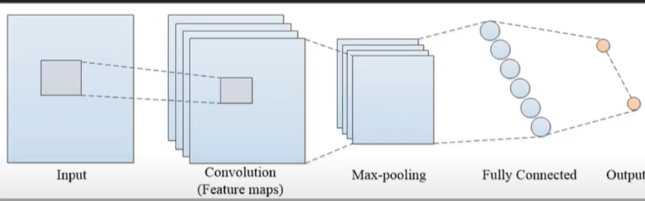
DIAGRAM OF CONVOLUTION TECHNIQUE
This Diagram show the method that are happening in our technique first it will take input and then CNN technique is happening then max pooling way with a fully connected everything and then final output.

Slide 11
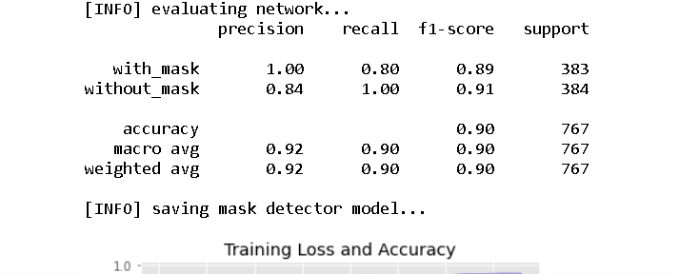
FACE DETECTOR ACCURACY
WITH MASK : 89%
WITHOUT MASK : 91%
AVERAGE ACCURACY : 90%

Slide 12
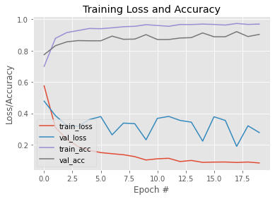
GRAPH B/W LOSS/ACCURACY & EPOCH
FROM THIS ABOVE GRAPH WE CAN CLEARLY SEE THE LOSS AND ACCURACY OF EPOCH FOR VARIOUS VALUES.

Slide 13
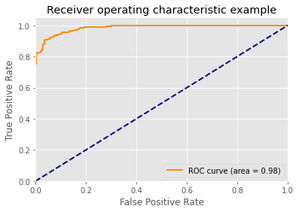
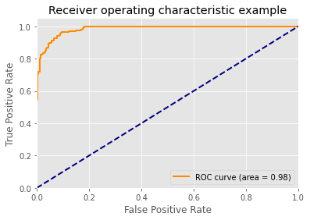
ROC AND AUC CURVE

Slide 14
FEATURES
It will take image very clearly.
It will show the people wearing mask or not, if person is wearing mask it will make a GREEN BOX with how much face is covered and if not it will make a RED BOX.
It will show the accuracy of 90% of face detector system and above is the graph given for the same.
It will be helpful in predicting the person is wearing mask or not, as we know that COVID – 19 period is going on.

Slide 15
REFERENCE
From various research papers on face mask detection in IEEE format
1. Q Wang, C Yu, Letter to editor: Role of masks/respirator protection against 2019-novel corona virus (COVID-19). Infect. Control. & Hosp. Epidemiology., 1–7 (year?).
2. S Fang, et al., Rational use of face masks in the COVID-19 pandemic. The Lancet Respire. Medicine 0 (2020).
3. J Duguid, The size and the duration of air-carriage of respiratory droplets and droplet-nuclei. Epidemiology. & Infect. 44, 471–479 (1946).
4. L Morawska, et al., Size distribution and sites of origin of droplets expelled from the human respiratory tract during expiratory activities. J. Aerosol Sci. 40, 256–269 (2009).
5. L Bourouiba, Turbulent Gas Clouds and Respiratory Pathogen Emissions: Potential Implications for Reducing Transmission of COVID-19. JAMA (2020).
6. P Anfinrud, CE Bax, V Stadnytskyi, A Bax, Could sars-cov-2 be transmitted via speech droplets? medRxiv (2020).
7. N Ferguson, et al., Report 9: Impact of non-pharmaceutical interventions (npis) to reduce covid19 mortality and healthcare demand (2020).

